Slide 1
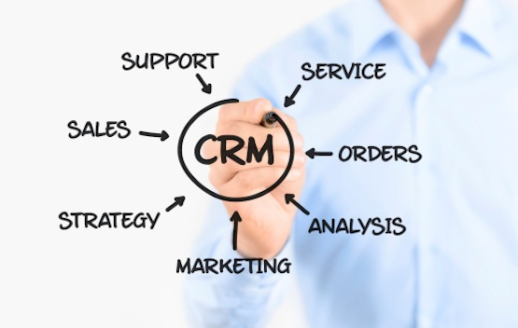
Analytical CRM Development for a Bank
From – A . SREELASHA

Slide 2
BANK-CHURN-ANALYSIS
Objective is to extract meaningful insights from various customer-releated data Sets ,with the help of SQL and power BI Dashboard The bank aims to reduce customer churn, improve service delivery, and enhance customer satisfaction. I have Provide with datasets including customer demographics, transaction details, customer exit information and active customer profile
DATA PREPARATION : Explore and clean datasets, merging relevant data for analysis key Customer Segmentation: Customer churn is increasing steadily, indicating the need for better retention strategies.
Churn Analysis: identify reasons for customer customer attrition using transaction data and demographics
Delivery Analysis : Evaluate response and resolution times, identify areas for improvement. Customer satisfaction

Slide 3
Analysis: Analyze feedback data to measure satisfaction level and address concerns.
Power BI Dashboard Creation: Design interactive dashboard showcasing key insights and trends for stakeholders and we can modify the data with the help of Dax functions.
Optimization : continuously monitor metrics, gather feedback, and iterate on dashboard design for on going improvement.

Slide 4
Data Introduction
RowNumber: The row number in the dataset, likely used for reference or indexing.
CreditScore: A numerical representation of the customer’s creditworthiness.
Credit score:
Excellent: 800–850
Very Good: 740–799
Good: 670–739
Fair: 580–669
Poor: 300–579
GeographyID: A numerical identifier that likely corresponds to a geographical location, such as a country or region.
GenderID: A numerical identifier for the customer's gender, where for example, '1' could represent male and '2' could represent female.

Slide 5
Age: The age of the customer.
Tenure: The number of years the customer has been with the bank.
Balance: Current balance in the customer's account.
NumOfProducts: refers to the number of products that a customer has purchased through the bank.
HasCrCard: denotes whether or not a customer has a credit card. This column is also relevant, since people with a credit card are less likely to leave the bank.
1 represents credit card holder
0 represents non credit card holder
IsActiveMember: active customers are less likely to leave the bank (as per the criteria defined by the bank for identifying the activeness).
1 represents Active Member
0 represents Inactive Member
Estimated Salary: as with balance, people with lower salaries are more likely to leave the bank compared to those with higher salaries.
Exited: whether or not the customer left the bank.
0 represents Retain
1 represents Exit
Bank DOJ: date when the Customer associated/joined with the bank.

Slide 6
Customer Churn and its impact on business
Customer churn, the rate at which customers stop using a company's products or services, is a crucial metric for banks.
It directly impacts revenue and profitability.
In this presentation, we will analyze our bank's customer churn rates, focusing on gender, recent years, customers with credit cards, number of products used, credit score-wise churn count, and geography-wise churn count.
Our goal is to identify factors contributing to churn and propose strategies to improve customer retention and satisfaction.

Slide 7
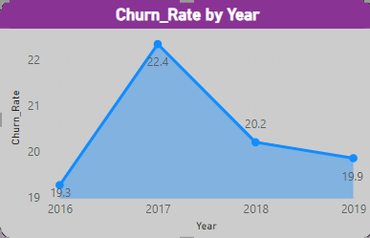
Churn Rate Trends
Analysis:
Significant increase in 2017 (22%).
Stabilized in 2018 and 2019 (20% each).
Recommendation:
Monitor closely for emerging trends.
Implement targeted strategies for stability.

Slide 8
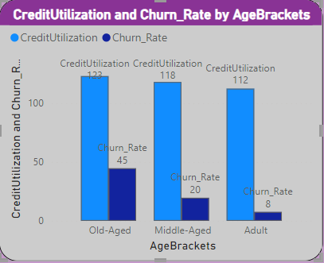
Churn Analysis by Age
Analysis:
Age Group Old Aged(45 Churn Rate):
High churn rate suggests potential dissatisfaction or unmet needs.
Reasons could include lack of personalized services or better offers
from competitors.
Recommend further investigation into specific pain points or service gaps.
Age Group Middle Aged (20 Churn Rate):
Significant churn rate indicating possible issues.
Factors may include retirement planning or changing financial priorities.
Tailor retention strategies based on understanding their financial needs and concerns.

Slide 9
Suggestions:
Targeted Marketing and Communication:
Develop campaigns focused on their financial goals.
Highlight services like retirement planning and investment options
Personalized Offers and Services:
Offer tailored product bundles and exclusive discounts.
Customer Loyalty Programs:
Implement programs rewarding long-term customers.
Improved Customer Service:
Enhance support for older customers.
Train reps to address their unique concerns
Product Bundling and Cross-Selling:
Create bundled offerings to encourage multiple product usage.

Slide 10
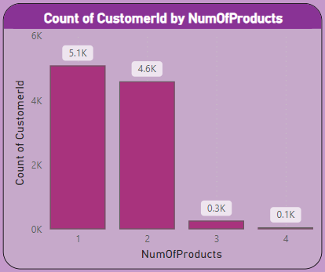
Count of customer Id by Number of Products.
Key Points:
Customers using 1 product have highest count (5.1K).
Count decreases as the number of products used increases.
Suggest product bundling to incentivize multiple product usage
Analysis:
Single-product customers may due to limited banking needs
or perceived value.
Multiple-product users are more loyal, indicating a need to
encourage product diversification

Slide 11
Recommendations:
Offer bundled products or incentives for multiple product adoption.
Educate customers on the benefits of multiple products.
Enhance value proposition for using multiple products
Use data analytics for personalized product recommendations.
Launch targeted retention campaigns for single-product customers

Slide 12
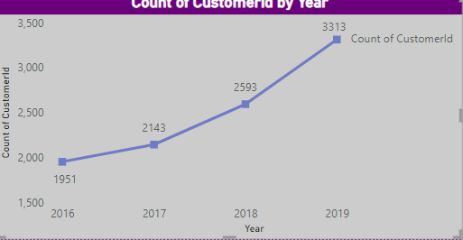
Customer joining over year
Analysis:
The increase in new customers joining
the bank each year is a positive trend,
indicating potential growth opportunities.
However, the constant churn rate
suggests that while new customers are
joining, the bank is struggling to retain them.

Slide 13
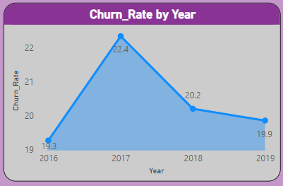
Churn rate by year
Analysis:
Fluctuations in churn rates occurred, but overall,
the rate has stabilized.
Minor increase in 2017, but stabilized in
subsequent years.

Slide 14
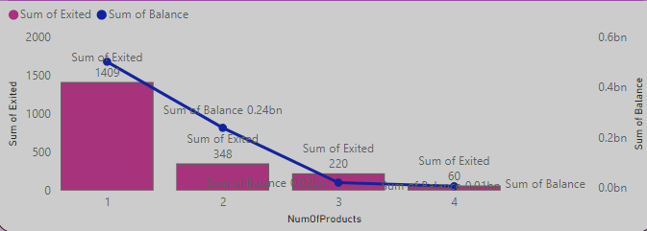
Account balance by Number of products
Analysis:
Customers with higher product usage tend to
have higher total account balances.
Customers using 1 product contribute
significantly to the total account balance.
Recommendation:
Encourage customers to use multiple products
to increase overall account balances.
Offer incentives or rewards for customers
who adopt additional banking products.

Slide 15
Conclusion
The bank has experienced a consistent churn rate over the years, despite a steady increase in customer acquisition.
Customers with lower credit scores and those using fewer products are more likely to churn.
Age groups Old and Middle have the highest churn rates, indicating specific retention challenges.
Improving customer engagement, enhancing customer service, and offering competitive products/services are key strategies to reduce churn.
Targeted marketing and personalized offers can help retain customers in critical age and credit score groups.
Overall, by focusing on customer engagement, service enhancement, and targeted strategies for specific customer segments, the bank can reduce churn, improve customer retention, and foster long-term customer loyalty.

Slide 16
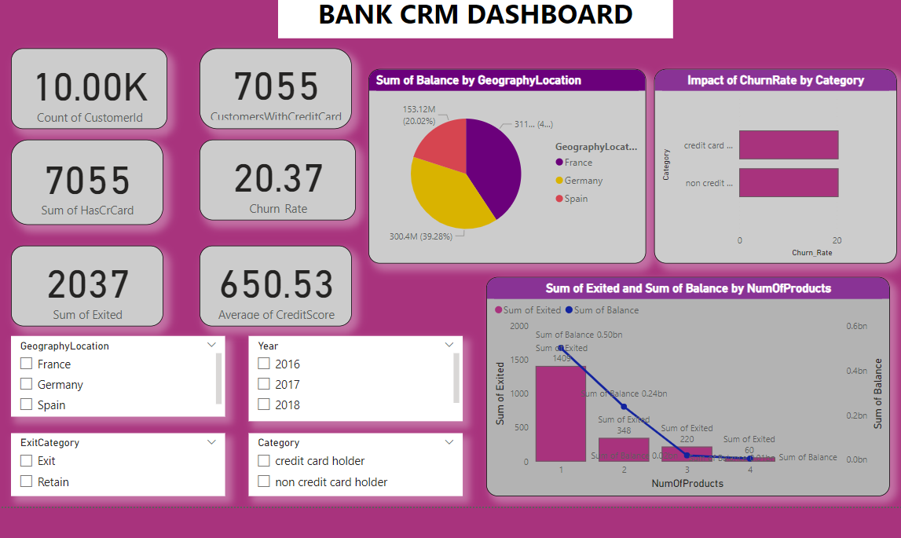

Slide 17
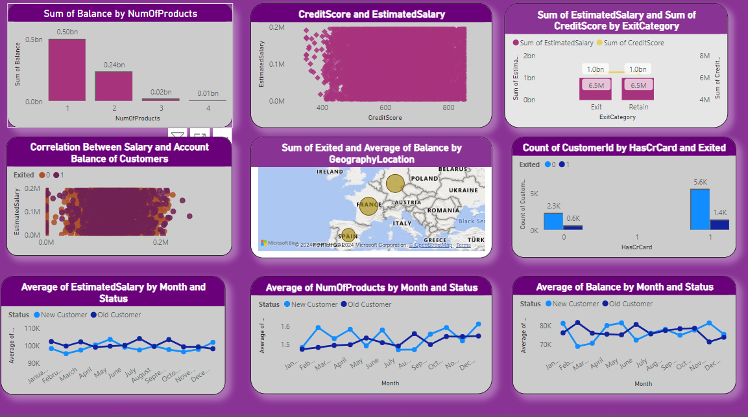

Slide 18
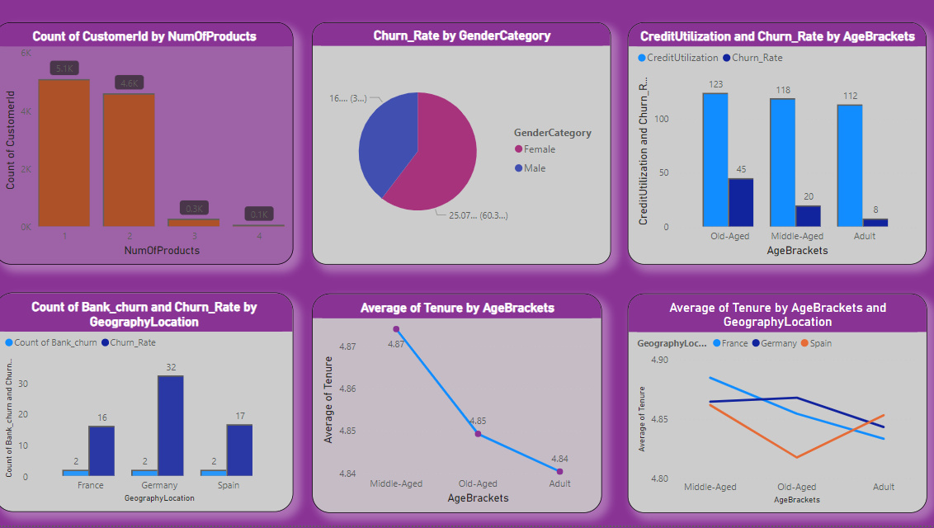

Slide 19
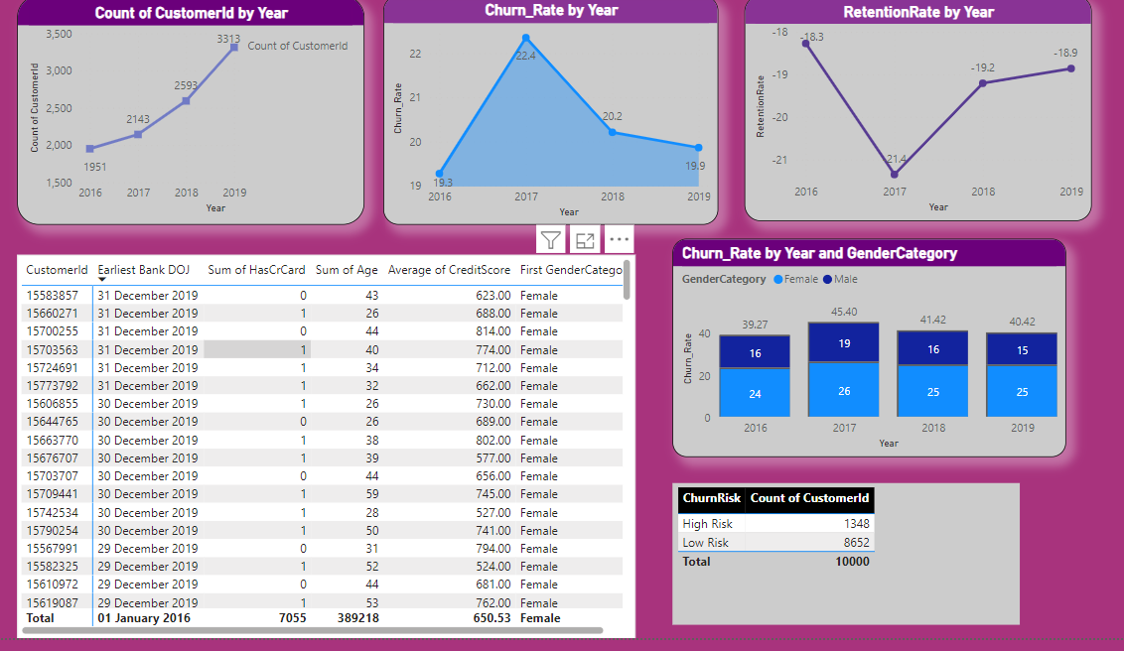

Slide 20


